Slide 1
IS YOUR HEART HEALTHY?
Cardiovascular Disease Prediction Portal
Django Based Web Application

Slide 2
MINI PROJECT Department of CSE , ABESIT, Ghaziabad
Team Members :- Supervisor:-
Rishabh Kumar (1902900100135) Ms. Jyoti Thakur
Saksham Vashistha (1902900100140)
Shivam Sharma (1902900100149)

Slide 3
Introduction
In this modern world, we humans are trying to make our life to live comfortably, but most of us don’t know about ourself Is he/she healthy or not. We are trying to live our life comfortably but not healthy which are two different things. Technology and Machines made it easier but it also affects nature. As Heart is main Component of our Body and there is high risk of having Heart Diseases from Pollution. That’s why we made this Prediction Portal in which users can check easily for their heart disease. The Prediction Model uses basic input features like Age, Height, Weight, Blood Pressure, Cholesterol, Glucose, Smoking, Alcohol, and gives output as Yes or No for Cardiovascular Disease.

Slide 4
Technologies Used :
PYTHON
Python is a high-level, interpreted, general-purpose language, created by Guido-van-Rossum and released in 1991. It is open-source, supported by many individuals. Python’s design philosophy emphasizes code readability with its notable use of significant whitespaces (known as, indentation). Its Language constructs and object-oriented approach aim to help programmers write clear, logical code for small- and large-scale projects.

Slide 5
Python Libraries Used:-
Pandas – used to handle Dataset.
Matplotlib – used to Plot Graph of population rates, over past 70 years.
Scikit-Learn – This library contains most of the tools and techniques related to Machine Learning.
Joblib – This library is used to implement lightweight pipelines.
Django – It is an open-source, web framework based on python language.

Slide 6
Web Scraping [used to fetch best Hospitals location over the world.]
Urllib : A library that does all the socket for us and make webpages look like a file.
Json : It stands for JavaScript object notation. It is used for data interchanging format.
Sqlite : Provides a SQL interface to store data as it is integrated in Python 3.
http : A library that collects module for working with HTTP.
time : A library that give time access and conversions.
ssl : It helps access to transport layer security (secure sockets layer) encryption and peer authentication facilities for network sockets, both client side and serve side.

Slide 7
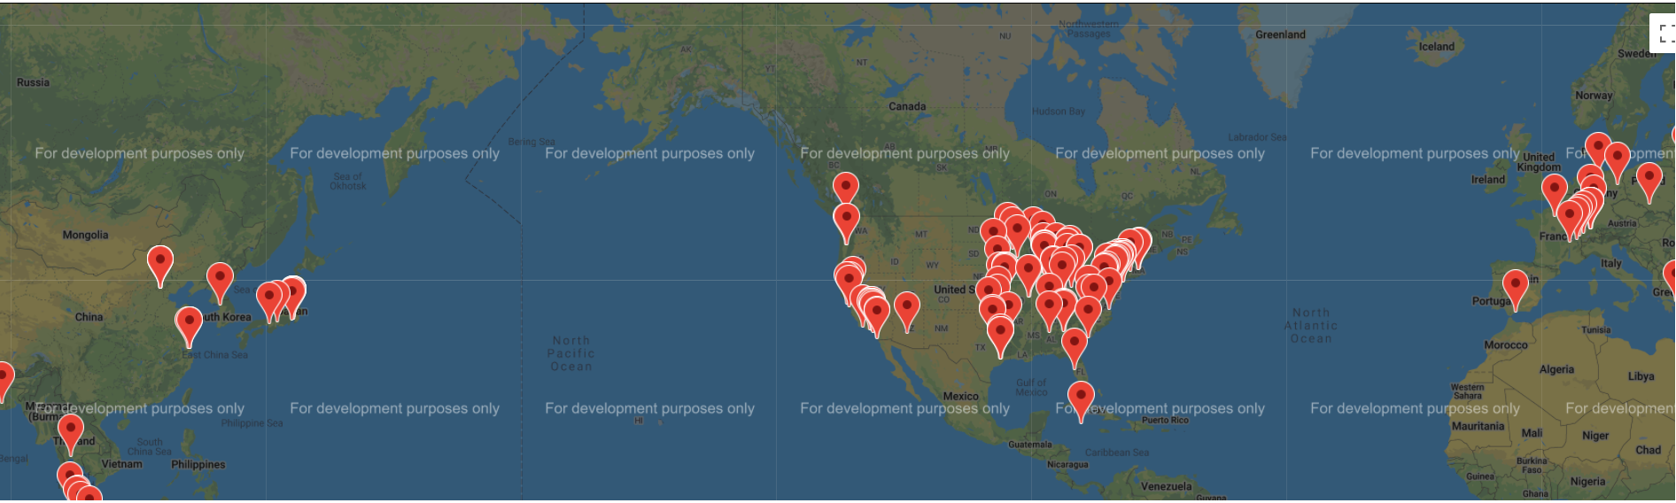
Best Hospitals across the world

Slide 8
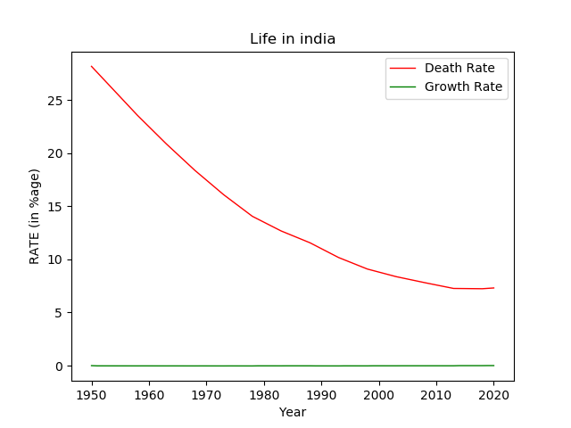
Plots :- Here, Python based matplotlib library is used to plot these graph of past 70 years of different countries.
S. No. | Year | Death Rate | Growth Rate
1 | 2020 | 7.309 | 0.0049
2 | 2019 | 7.273 | 0.005
3 | 2018 | 7.237 | -0.0007
4 | 2017 | 7.242 | -0.0007
5 | 2016 | 7.247 | -0.0008
6 | 2015 | 7.253 | -0.0007

Slide 9
Dataset used to Test and Train Prediction Model. [Total Size - 70000*11 ,Testing size – 30%]
age | gender | height | weight | ap_hi | ap_lo | cholesterol | gluc | smoke | alco | cardio
18393 | 2 | 168 | 62 | 110 | 80 | 1 | 1 | 0 | 0 | 0
20228 | 1 | 156 | 85 | 140 | 90 | 3 | 1 | 0 | 0 | 1
18857 | 1 | 165 | 64 | 130 | 70 | 3 | 1 | 0 | 0 | 1
17623 | 2 | 169 | 82 | 150 | 100 | 1 | 1 | 0 | 0 | 1
17474 | 1 | 156 | 56 | 100 | 60 | 1 | 1 | 0 | 0 | 0
21914 | 1 | 151 | 67 | 120 | 80 | 2 | 2 | 0 | 0 | 0
22113 | 1 | 157 | 93 | 130 | 80 | 3 | 1 | 0 | 0 | 0
22584 | 2 | 178 | 95 | 130 | 90 | 3 | 3 | 0 | 0 | 1
17668 | 1 | 158 | 71 | 110 | 70 | 1 | 1 | 0 | 0 | 0

Slide 10
FUTURE SCOPE :
This Project can Predict that a Human Heart is healthy or not, that Human has any Disease or not. He/she should consult a doctor or not. In this Matter, the best accuracy of the prediction model is Highly recommended, and the accuracy of our Model is only 72%. In future, we will try to increase its accuracy by providing it different dataset (if available), or by testing and applying different boosting techniques.
Secondly, the project consists of two 3rd party applications, Shop and COVID Tracker. We would change it too by creating our own interactive application, where, in shop section, we would suggest best online price of a medicine over Internet.

Slide 11
Limitations
An Internet Connection is Required.
The Accuracy of Prediction Model is good, but not best (numbered 72.3%).
User can see Hospitals address, but not exact co-ordinates or location.
Donations page is not connected with any payment gateway which’ll point to a non-verified payment.

Slide 12
References
Aurélien Géron, Hands-On Machine Learning with Scikit-Learn and TensorFlow, California: O’Reilly Media, 2017.
Jason Brownlee, “How to Make Predictions with scikit-learn”, April 6, 2018, https://machinelearningmastery.com/make-predictions-scikit-learn/
CodeWithHarry, “Python Django Tutorials”, YouTube, Retrieved January 27, 2019, from https://www.youtube.com/watch?v=5BDgKJFZMl8&list=PLu0W_9lII9ah7DDtYtflgwMwpT3xmjXY9/
Svetlana Ulianova: Cardiovascular Disease Dataset, Jan 2019, Kaggle https://www.kaggle.com/sulianova/cardiovascular-disease-dataset/
Data Source: United Nations - World Population Prospects, “Death Rate” Retrieved September 16, 2020, Macrotrends https://www.macrotrends.net/countries/IND/india/death-rate/
Data Source: United Nations - World Population Prospects, “Growth Rate” Retrieved September 16, 2020, Macrotrends https://www.macrotrends.net/countries/IND/india/birth-rate/

Slide 13
THANK YOU

